Slide 1


Dronemaster Event
Programing with Tello EDU
Rajesh Raveendran

Slide 2
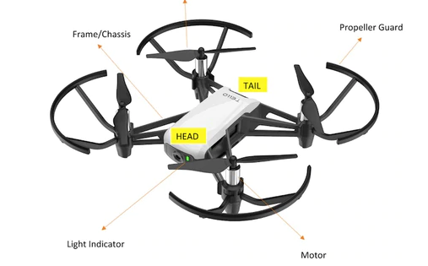
Introduction to Tello Drone
Tello drone is a WiFi controlled vision-based RTF drone, developed by RYZE Robotics Shenzen in cooperation and sold by DJI technology.
In this demonstration you will understand how to program a tiny drone and control it.
All the codes will be available to you.

Slide 3
Tello Pro’s and Con’s
Pro’s
With Tello one can start programming Drones safely and most of the control and autonomous features that can be programmed with Tello are exportable to any other drones.
With DJI Tello EDU drone one can easily start research in the area of autonomous drone racing. Because it is relatively cheap, affordable, and safe.
It allows both manual and autonomous control from the level of software running on a ground station, such as a laptop or Nvidia Jetson board.
Con’s
One of its major drawbacks is the control of only (vx; vy; vz; wz) velocity vector, while custom drones allow to directly control of (roll; pitch; yaw) angles.
The operation and settings of the internal controller are implemented by the manufacturer and not directly available to the user. (for example the path generated cannot be obtained)

Slide 4
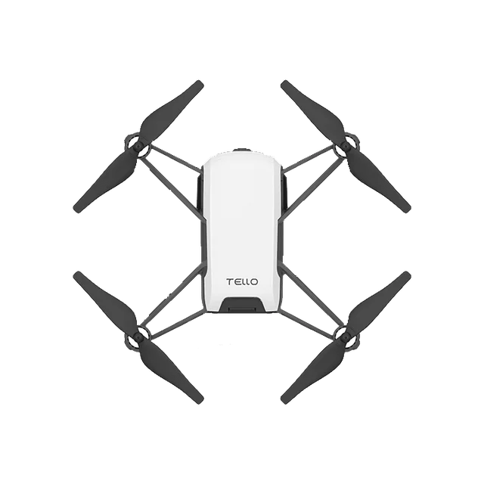
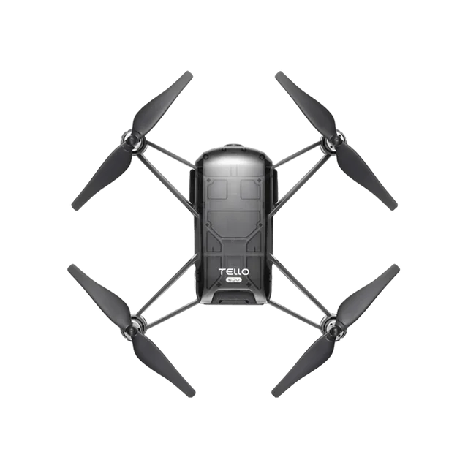
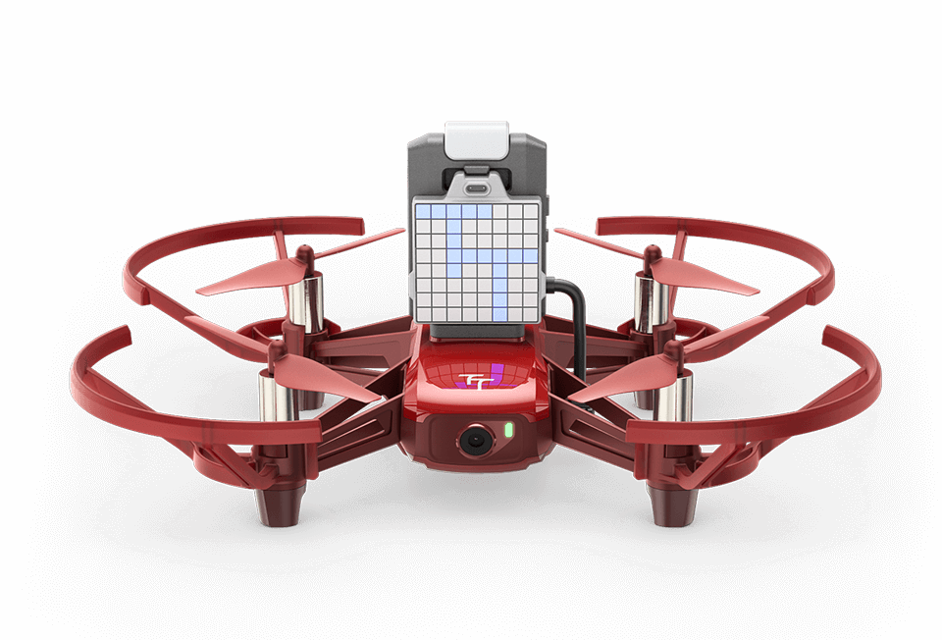
Tello Drones
Tello Tello EDU Tello Talent
Tello EDU comes with what DJI calls mission pads and are essentially mouse pad size fancy QR codes that can be used with object recognition coding.
Tello EDU has more access to the SDK (software Developers Kit), than the consumer range Tello, for more advanced coding features.
Tello Talent also comes with the mission pads, as well as a ESP32 open-source controller that clips onto the top with a Lego type connection and is powered via the micro-USB port on the side of the drone.
Tello Talent supports Arduino and Micro Python, a programmable dot matrix LED screen, distance measurement and obstacle avoidance, and the ability to integrate other sensors.

Slide 5
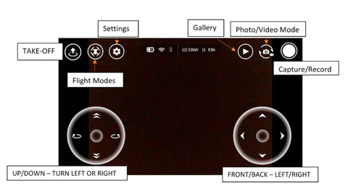
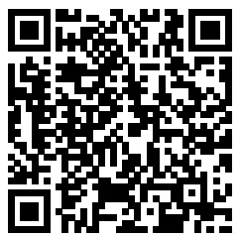
Download the Tello App
Search for “Tello” on the App Store or Google Play or scan the QR code on the right to download the latest version of the app. The Android version of the Tello app is compatible with Android v4.4 and later. The iOS version of the Tello app is compatible with iOS v9.0 and later. Read more: https://manuals.plus/ryze-tech/tello-aircraft-manual#ixzz7VP9WMCch

Slide 6
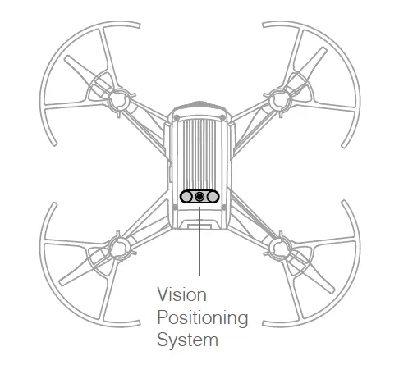
How does Tello stabilizes?
Vision Positioning System (VPS) helps the aircraft to stabilize in given position more precisely and enables to fly indoors/outdoors.
VPS works optimal in windless conditions.
VPS consists of camera and a 3D infrared module located on the underside of the aircraft.
We can get fusion based (IMU and Vision)
distance.
(downward IR sensitive camera optical flow)
Based on this it uses odometry.
Algorithm: Dead reckoning from motion model
(Position form velocity time integral)
Algorithm: dead-reckoning from motion model

Slide 7
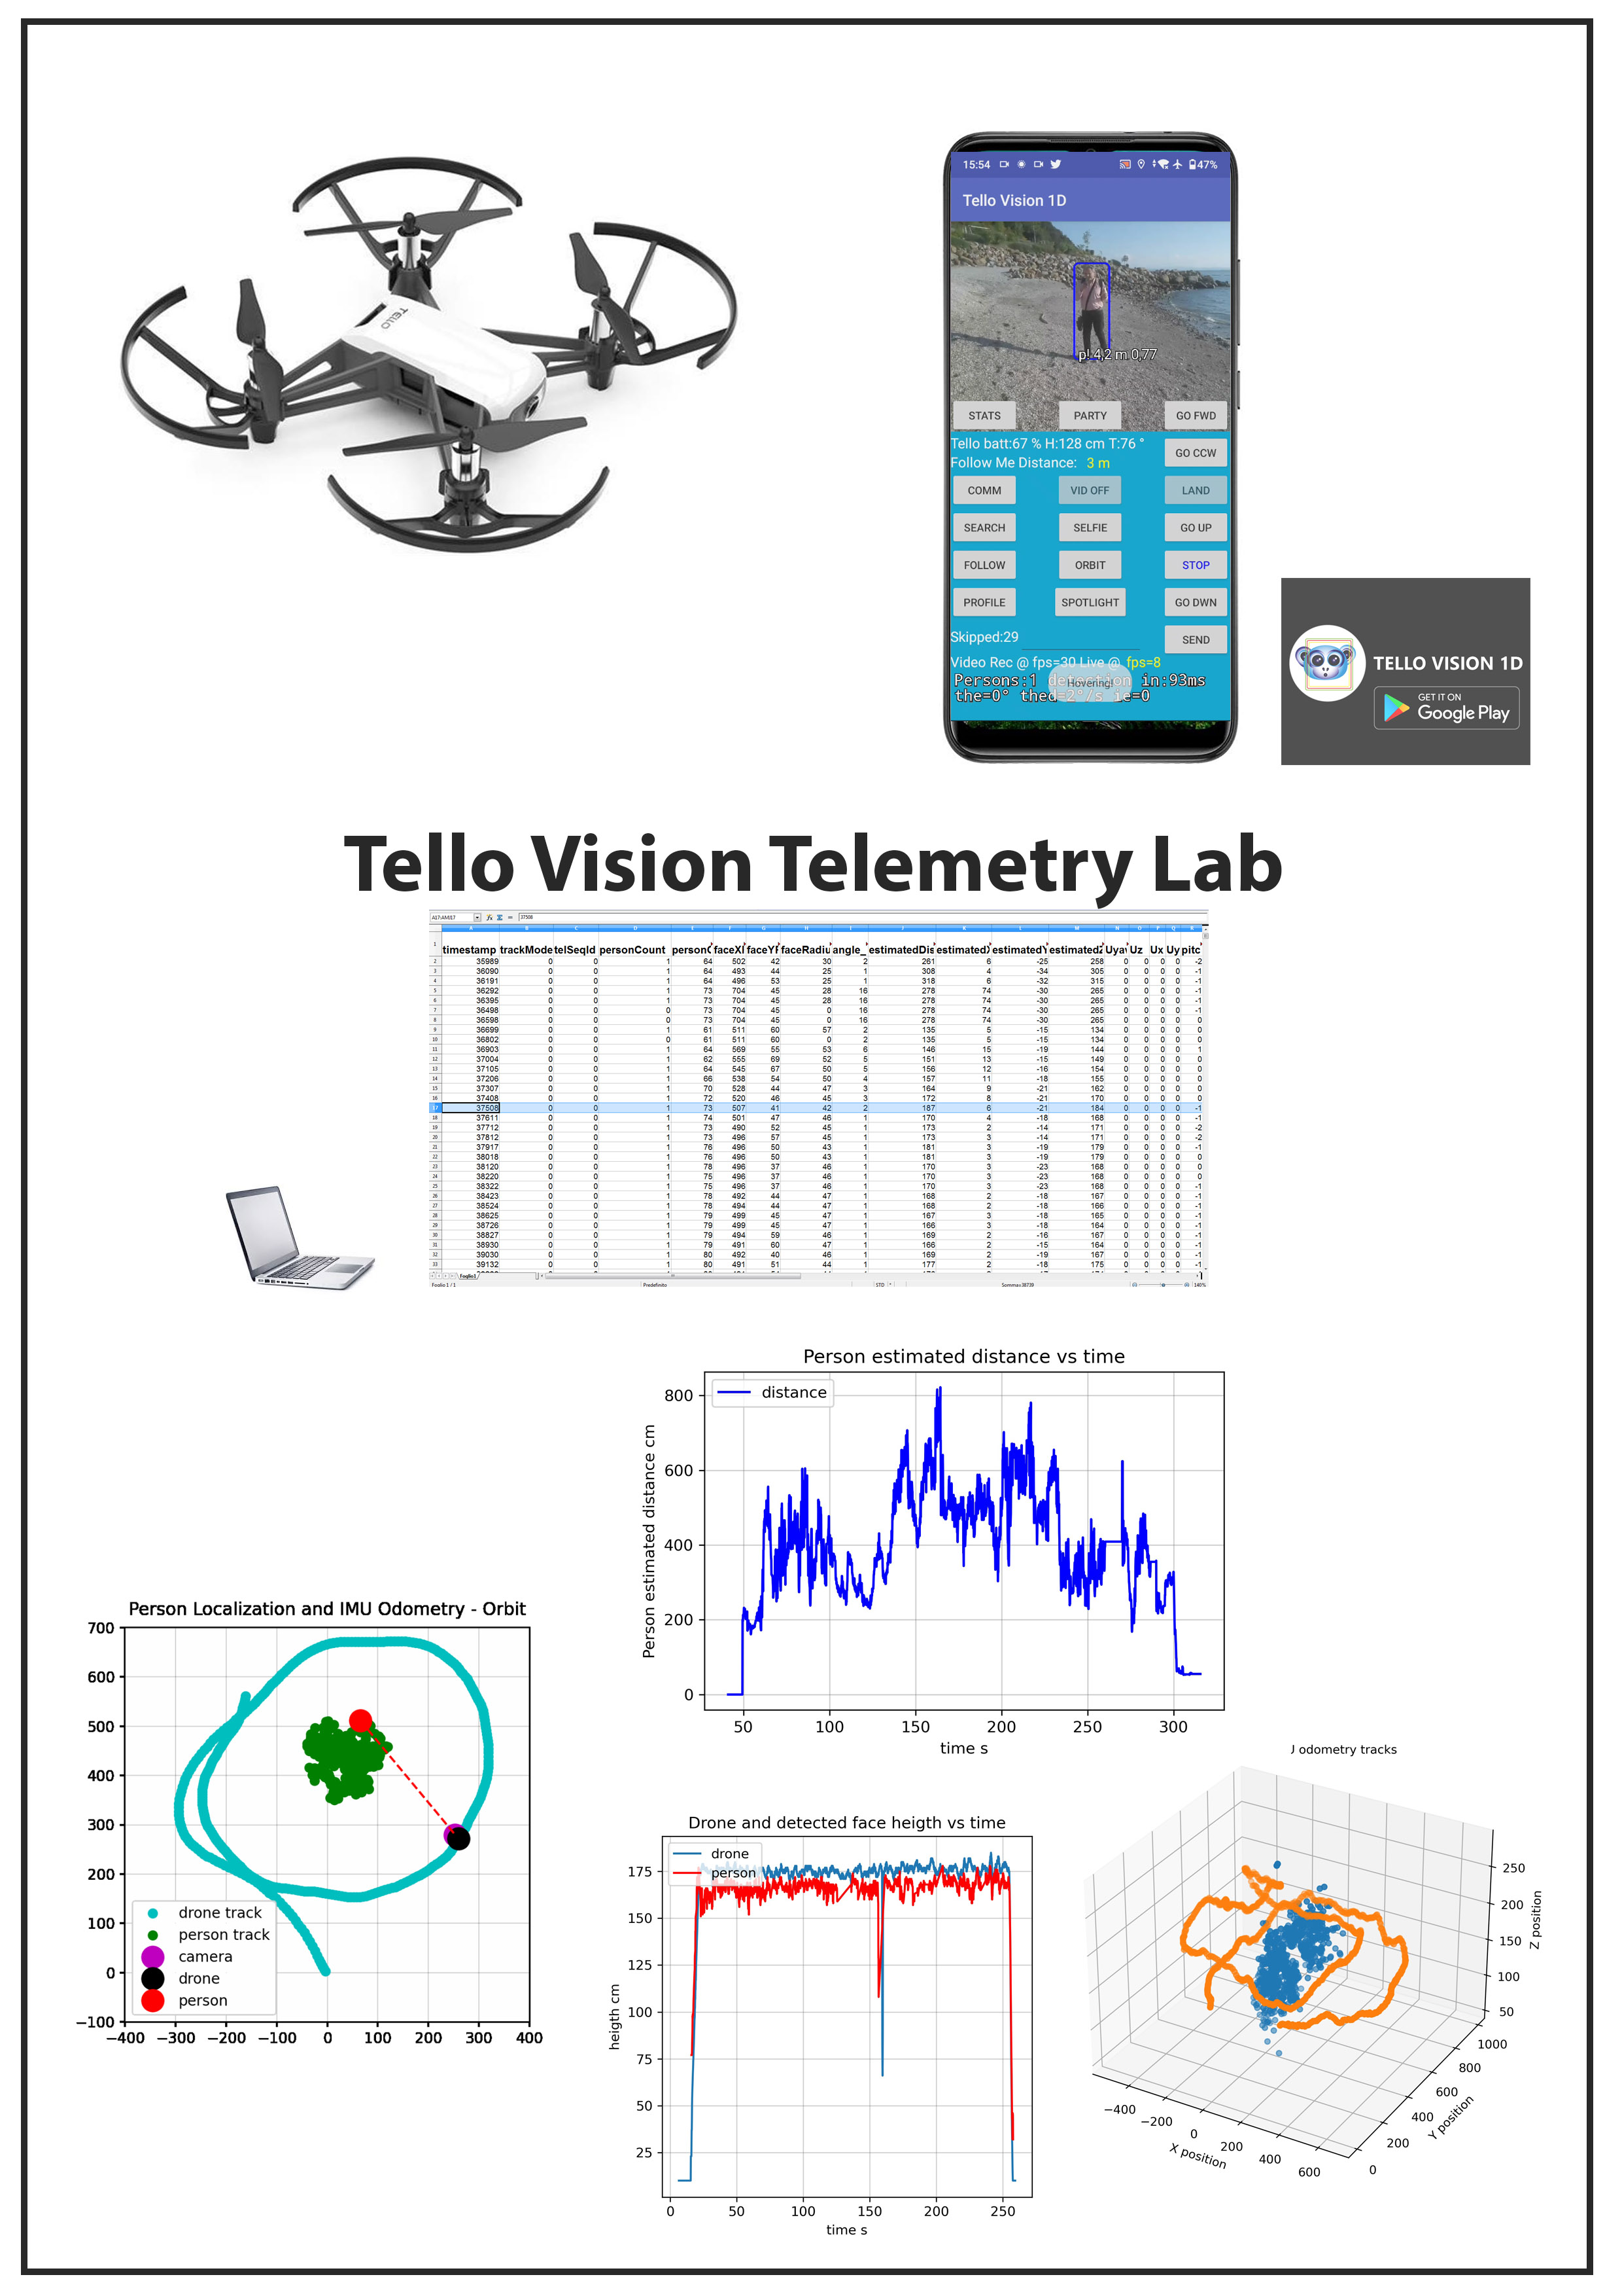
Tello Telemetry Analysis

Slide 8
Tello Software Development Kit (SDK)
You may establish a UPD connection to the Tello on port 8889 and send commands.
There are four versions of SDK to communicate with the Tello series.
1.0 SDK Tello
1.3 SDK Tello
2.0 SDK Tello EDU
3.0 SDK Tello Talent

Slide 9
Wrappers for DJI Tello SDK’s
In this demonstration we are focusing on Tello EDU SDK.
We are using DJITelloPy which is the official wrapper for Tello SDK and Tello EDU SDK.
For other Libraries based on C++, RUST, ROS, Go, Matlab etc. please refer
https://github.com/Matthias84/awesome-tello.

Slide 10
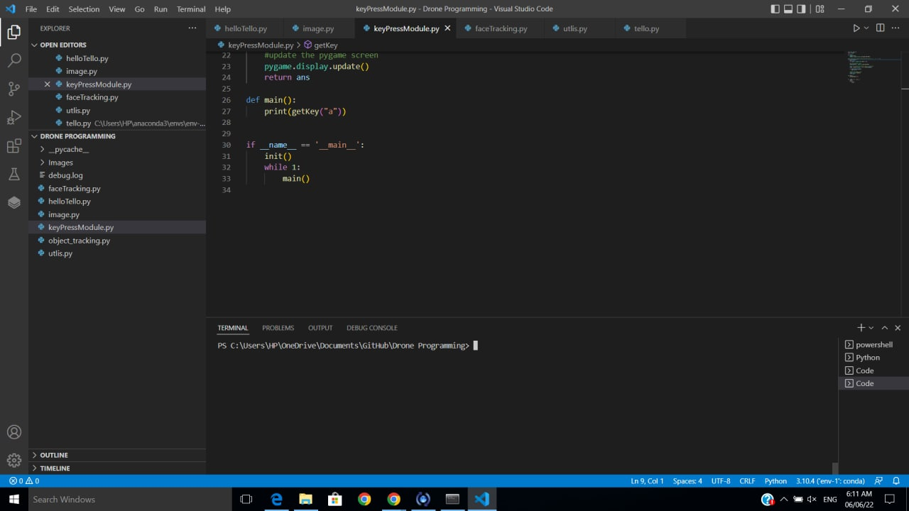
Requirements
1) Tello/Tello EDU
2) Remote Machine:
Windows/Linux
VSCode/PyCharm or any editor of your choice
3) Libraries used in this demonstration
python 3.10
djitellopy
numpy
opencv-python
Pygame
Darknet + OpenCv 4.5 + CUDA
YOLO4
Tips:
If you already have firmware 02.05.01.17 please don’t update to the latest version 02.05.01.19. Based on our experiments the earlier version works better.
If you have 02.05.01.19, force update with android based Tello App (1.4 version) for optimal performance.
Use ‘Conda’ to maintain the environments it can help you to test code that are available already and avoid dependency issues.

Slide 11
Demonstration
Basic movement with remote system
Image frame grabber
Keyboard control
Face Detection and Tracking with Darknet - Yolo

Slide 12
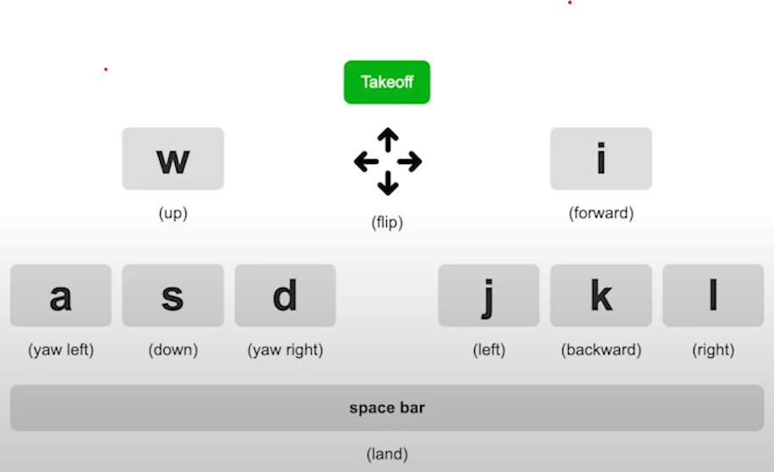
Keyboard Mapping

